Slide 1
Tumour targeting using scaffold proteins
Vladimir Tolmachev
Department of Immunology, Genetics and Pathology
Uppsala University, Uppsala, Sweden

Slide 2
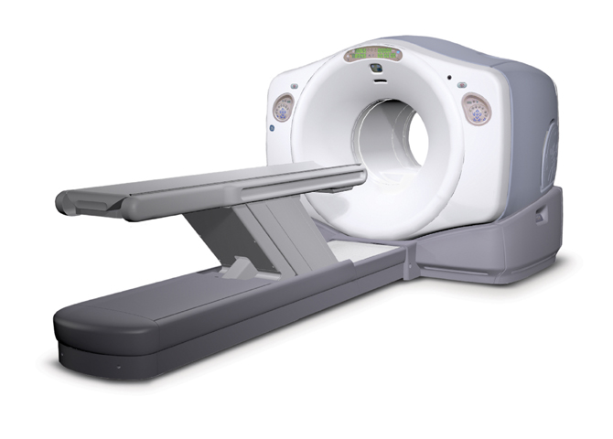
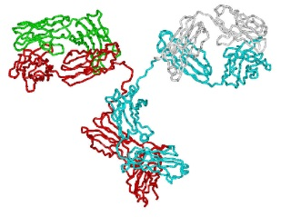
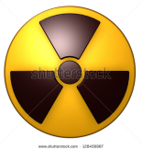
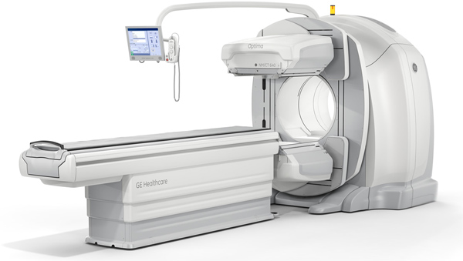
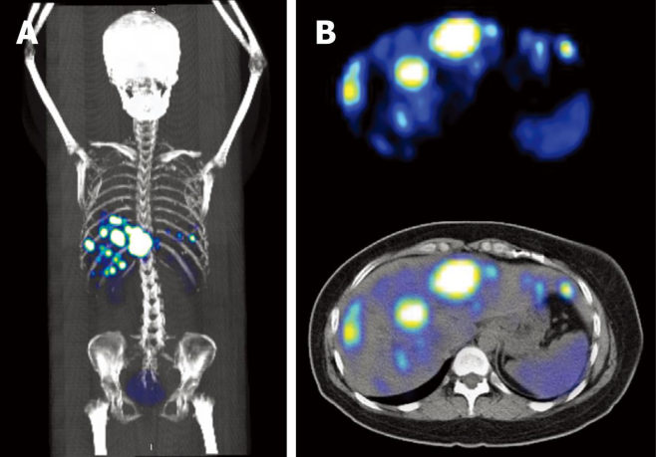
PET and SPECT can show if radiolabeled
antibodies accumulate in tumors
PET/CT
SPECT/CT

Slide 3
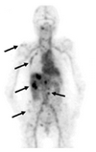
Problems with antibody imaging
Antibodies are too big!
Slow accumulation in tumors;
Slow clearance from normal organs;
Unspecific accumulation due to EPR.
Imaging at 5 days after injection !
Low contrast !
False-postive findings!

Slide 4
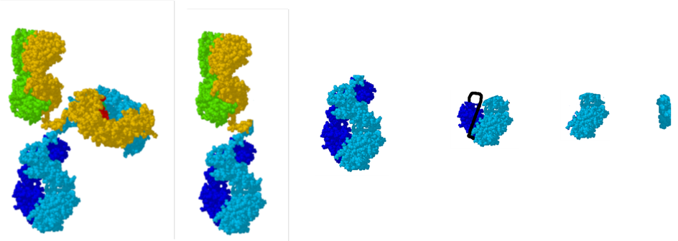
Size does matter!
Renal cut-off size
EPR cut-off size
IgG (Fab’)₂ Fab scFv VHH peptide
150kDa 110 kDa 55 kDa 26 kDa 15 kDa 1-2 kDa
Blood clearance rate
Extravasation / tissue penetration

Slide 5
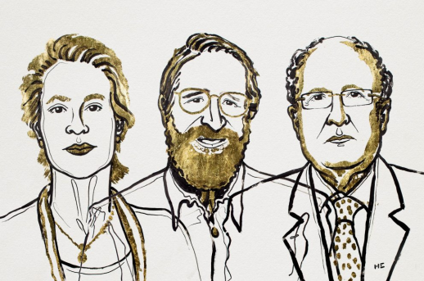
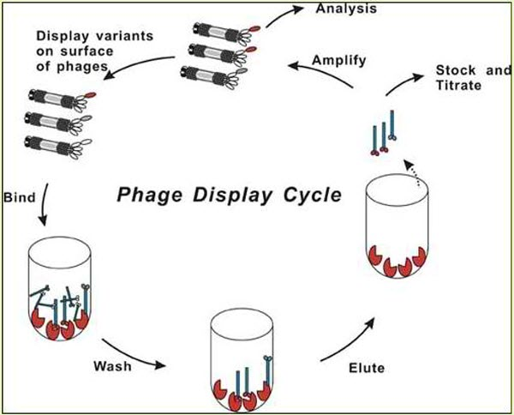

Phage display technology

Slide 6
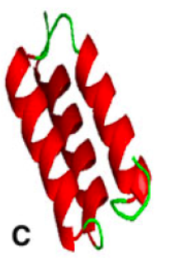

Scaffold proteins
Affibody DARPin anticalin
Robust framework providing structural stability;
Variable amino acids providing large combinatorial libraries enabling selection of high-affinity binders.
Vazquez-Lombardi:Drug Discov. Today, 2015: 1271
Simeon R: Protein Cell, 2018:3–14

Slide 7
Advantages of scaffold proteins as imaging probes
Small size
☞ rapid extravazation;
☞ rapid diffusion in extracellular space;
☞ rapid clearance of unbound probes
High affinity
Production using peptide synthesis
Recombinant production in prokaryotes
☞ low production costs;
Easy development of multivalent and multispecific constructs, fusion proteins and chimeras.

Slide 8
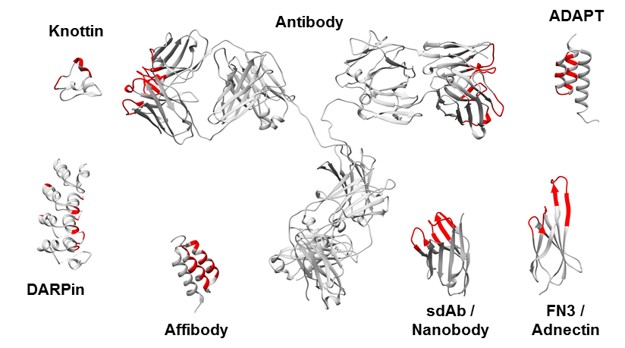
Some scaffold proteins evaluated for imaging
Krasniqi : J Nucl Med. 2018: 885-891.

Slide 9
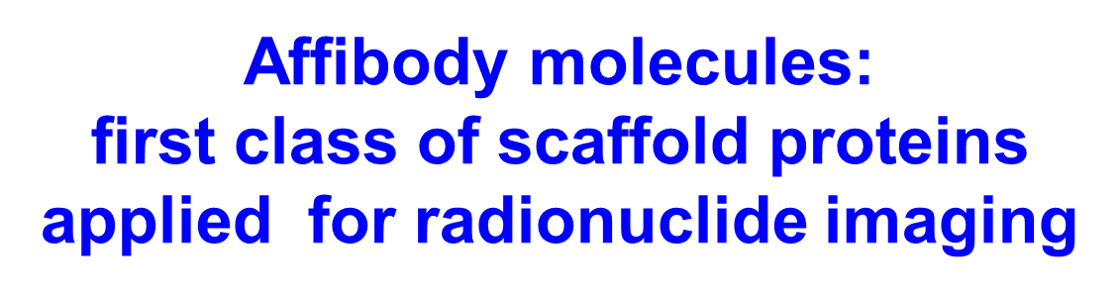
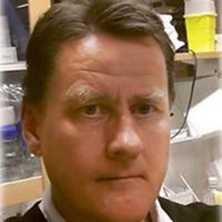

Slide 10
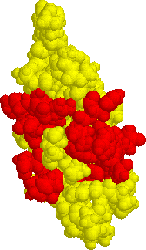
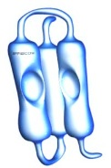
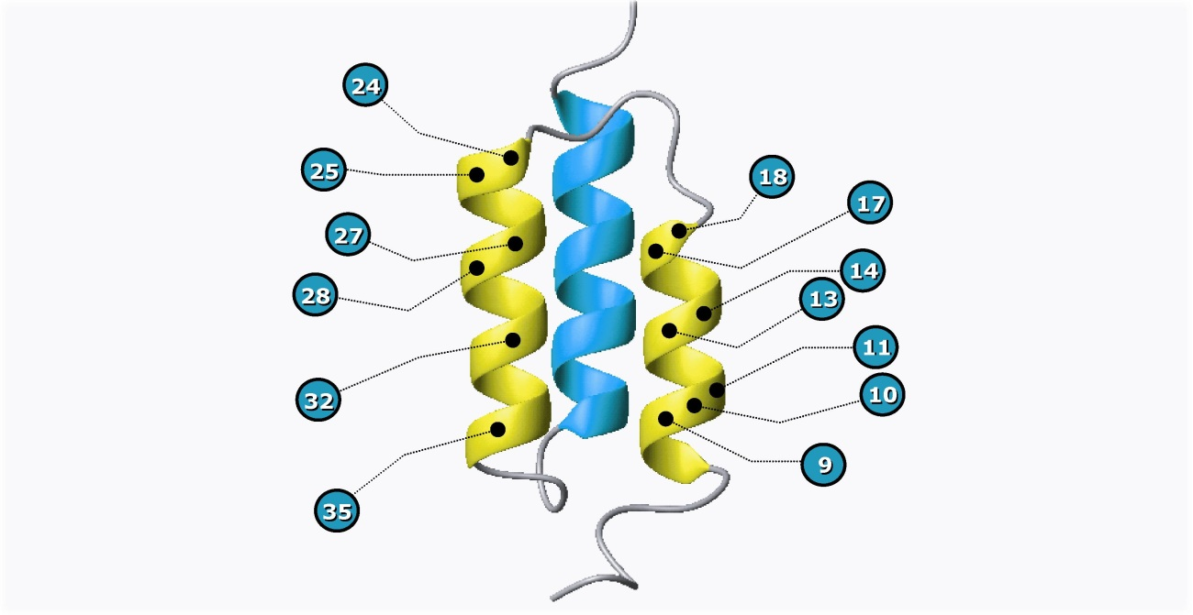
Affibody molecules:
first class of scaffold proteins applied for radionuclide imaging
Protein A-domain
scaffold
Randomization of 13
selected positions
2x10¹⁰ Affibody®
library members
Nord: Nat Biotechnol. 1997:772
Orlova: Cancer Res., 2006; 4339-48
Nygren: FEBS J. 2008: 2668-76.
Löfblom: FEBS Lett. 2010; 2670-80
58 amino acids (~ 7 kDa)

Slide 11
Affibody molecules vs antibodies: Superior contrast
¹²⁴I-PIB-Z_{HER2:342}
(Affibody molecule)
¹²⁴I-PIB-trastuzumab (antibody)
6h 24h 72 h
Orlova J Nucl Med 2009; 50:417–425

Slide 12
Affibody molecules vs antibody fragments: Superior contrast

Slide 13
Affibody molecules vs antibodies: Superior specificity
specific
specific
unspecific
unspecific
¹¹¹In-antibody ¹¹¹In-Affibody molecule
McLarty EJNMMI 2009; 36:81
Orlova Cancer Res 2007;67:2178

Slide 14
Labeling chemistry can influence:
target-binding properties of proteins;
cellular processing of a tracer and cellular retention of a radionuclide by cancer cells and normal tissues;
biodistribution and excretion pathways of proteins.
Development of labeling chemistry has to go hand in hand with biological evaluation

Slide 15
Residualizing vs non-residualizing labels
Residualizing labels improve tumor-to-organ ratios (imaging contrast) by increasing tumour associated radioactivity and decreasing level of blood-born radiocatabolites.
We should remember, that retention of internalised radioactivity in excretory organs, e.g. kidneys, will also be increased.
Internalisation rate is important!
For slowly internalizing tracers, residualizing properties
might be less critical.

Slide 16
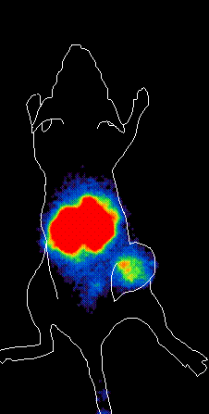
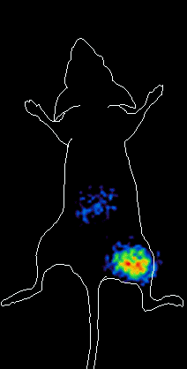
Residualizing vs non-residualizing labels
¹¹¹In-Bz-DTPA-
Z_{HER2:342}
¹²⁵I-PIB-
Z_{HER2:342}
Tolmachev: JNM, 2006:846 Orlova: Cancer Res, 2006:4339.

Slide 17
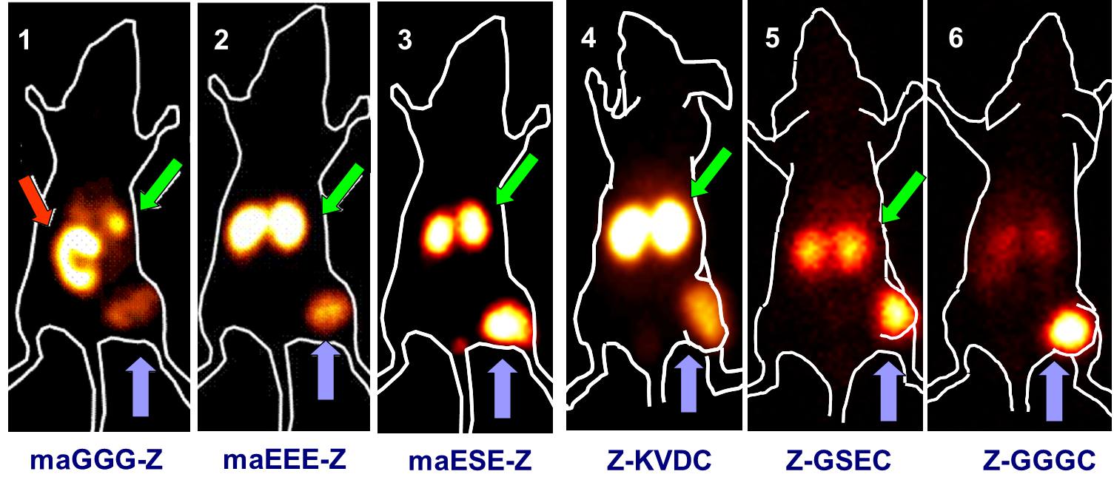
Imaging of HER2-expressing SKOV-3 xenografts using ^{99m}Tc-labelled Z_{HER2:342}
tumor
Engfeldt et al., Eur J Nucl Med 2007, 34 :722;
Tran et al., Bioconjugate Chem, 2007, 18:1956;
Ekblad et al., Eur J Nucl Med, 2008, 35:2245;
Ahlgren et al. J Nucl Med. 2009, 50:781;
5-6. Wållberg et al. J Nucl Med. 2011, 52: 461
caecum
kidneys

Slide 18
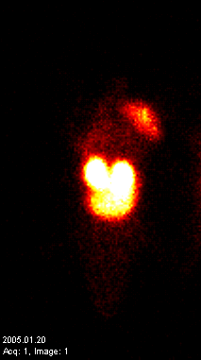
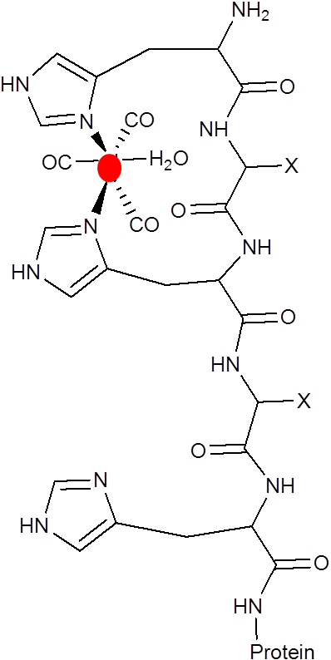
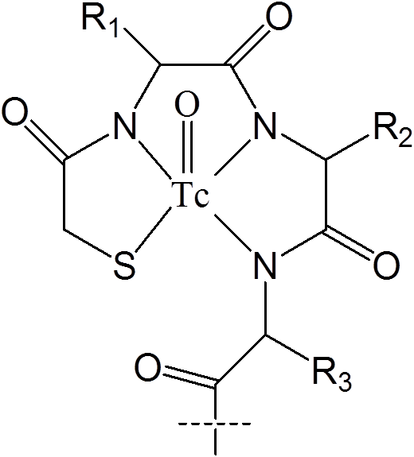
Problem: high liver uptake when His₆
-tag is placed at N-terminus of Z_{HER2:342}
L
K
T
^{99m}Tc(CO)₃-
His₆-Z_{HER2:342}
(IsoLink)
^{99m}Tc-maESE-
Z_{HER2:342}

Slide 19
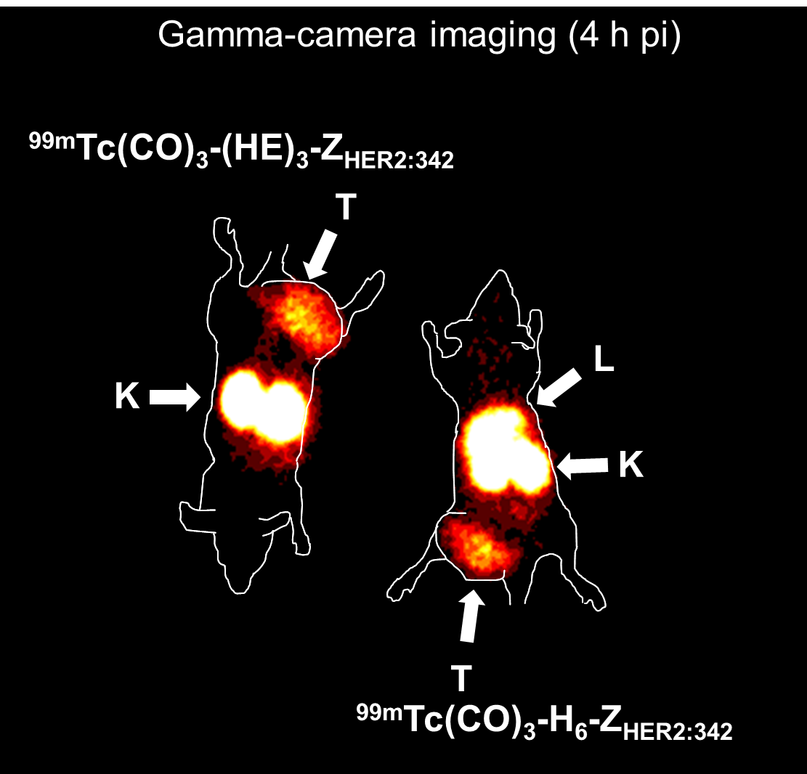

Slide 20
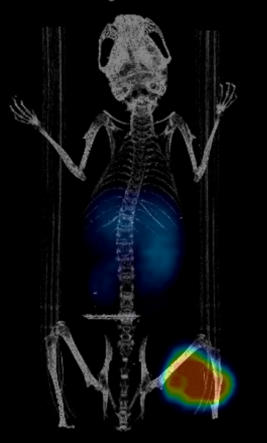
MicroPET imaging of HER2 expressing xenografts using ¹⁸F-labelled Affibody molecules, 2h pi
¹⁸F-Z2891-mal-FBO
¹⁸F-FBO-E₃-PEP4313
Glaser J Lab Comp Radiopharm
2013;56:S385
Rosik: Bioconjug Chem. 2014:82

Slide 21
Affibody molecules have been labelled for ….
SPECT PET Therapy
^{99m}Tc ¹⁸F ¹³¹I
¹¹¹In ⁷⁶Br ²¹¹At
¹²⁴I
¹²⁵⁽¹²³⁾I ⁹⁰Y
⁶⁸Ga ^{114m}In
⁵⁷⁽⁵⁵⁾Co ¹⁷⁷Lu
⁸⁹Zr
⁶⁴Cu ^{186/188}Re

Slide 22
Typical examples of cellular processing of affibody molecules in vitro
[¹¹¹In-maleimido-CHX-A’’-C⁶¹]-
Z_{HER2:2395}
SKOV-3 cells
[¹¹¹In-maleimido-DOTA-C⁶¹]-
Z_{EGFR:1907}
A431 cells
Tolmachev, Bioconjug Chem 2008:1579-87
Tolmachev, EJNMMI 2010: 613-622

Slide 23
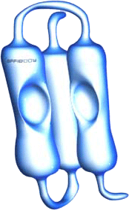
Slow internalization
Affinity should play a major role for tumour retention
Comparing two HER2-binding Affibody molecules
differing in the binding surface
D
Binding
Surface

Slide 24
The influence of affinity on tumour uptake
Affibody molecules site-specifically labelled at C-terminus using maleimido-DOTA
 | k_{a} (1/Ms) | k_{d} (1/s) | K_{D} (pM)
PEP05541 | (6.3± 1.1) ×10⁶ | (7.37± 1.33) ×10⁻⁴ | 116.7± 0.1
PEP07127 | (6.69 ± 0.01) ×10⁶ | (2.55 ± 0.12)×10⁻² | 3804 ± 178
BALB/C nu/nu mice (n=8 per data point)
xenografts:
SKOV-3 (~1.2 × 10⁶ HER2 per cell)
LS174T (~ 4 × 10⁴ HER2 per cell)
1 µg (0.13 nmol) per mouse
biodistribution at 4 and 24 h pi

Slide 25
Xenografts with high expression of HER2
4 h p.i. 24 h p.i.
Tolmachev J Nucl Med. 2012:953-60.

Slide 26
Xenografts with low expression of HER2
4 h p.i. 24 h p.i.
Tolmachev J Nucl Med. 2012:953-60.

Slide 27
The influence of affibody molecules affinity on tumour uptake
low nanomolar affinity is “good enough” for imaging of molecular targets with high expression level (around 1000000 per cell) shortly after injection;
for imaging of targets with low expression level (40000 per cell), subnanomolar affinity is desirable.

Slide 28
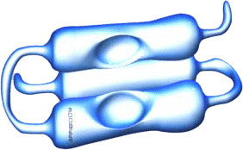
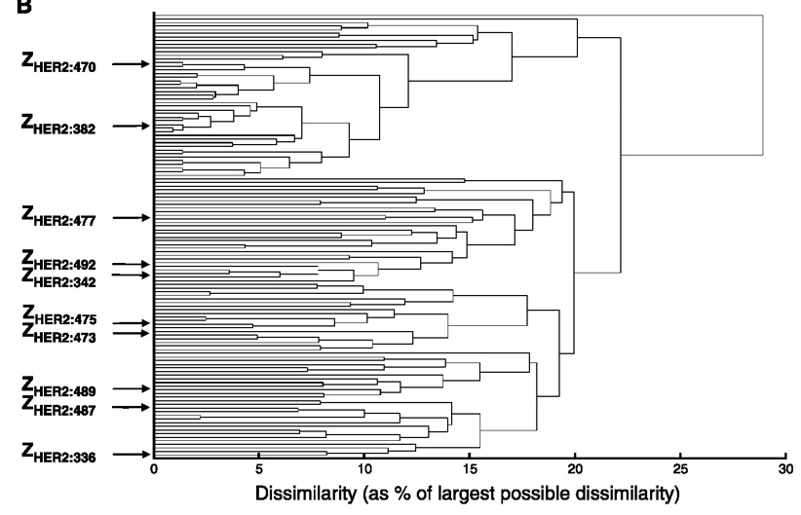
Approaches to increase affinity
dimerization;
+
=
affinity maturation

Slide 29

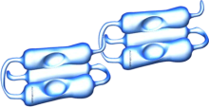

Anti-HER2 Affibody molecules:
SKOV-3 xenografts
¹²⁵I-Z_{HER2:4} 50 nM
¹²⁵I-(Z_{HER2:4})₂ (3 nM)
¹²⁵I-Z_{HER2:342} 22 pM
Orlova Cancer Res. 2006:4339-4348

Slide 30
Anti-HER2 Affibody molecules:
SKOV-3 xenografts
Tolmachev. Eur J Nucl Med Mol Imaging. 2009:692-701

Slide 31
Anti-HER2 Affibody molecules:
SKOV-3 xenografts
Cheng. J Nucl Med. 2008: 804-13.
Cheng. Mol Imaging Biol. 2010:
316-24

Slide 32
Dimerization vs affinity maturation
affinity maturation increases both uptake and retention of radionuclide in a tumour;
dimerization decreases off-rate and increases retention of radionuclide in tumours. It decreases, however, tumour uptake;
most likely, negative influence of dimerization on tumour uptake is associated with bigger size of the protein;
affinity maturation is preferable way of increasing affinity;

Slide 33
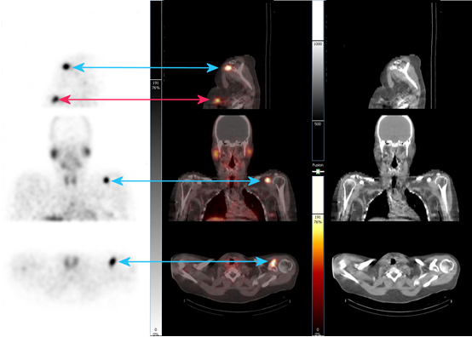
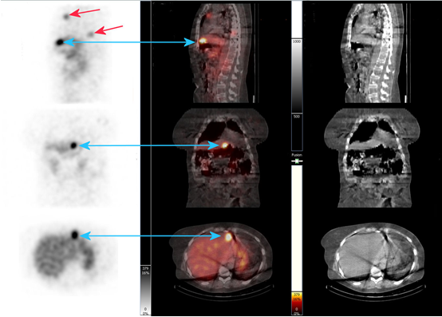
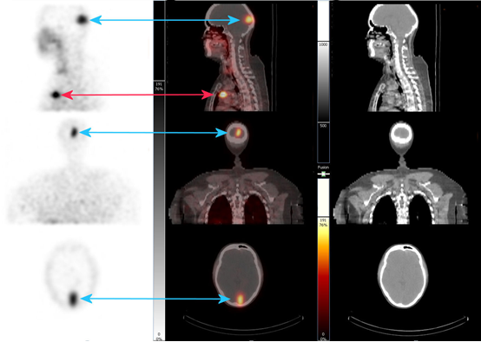
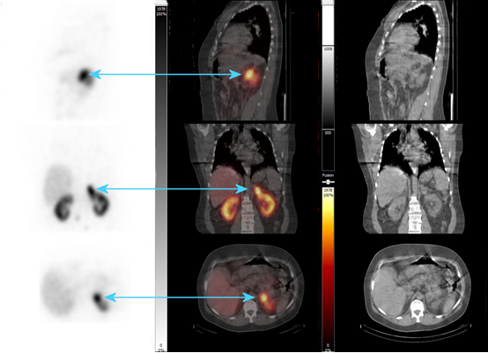
Phase I/II study of imaging of HER2 expression in breast cancer metastases using ¹¹¹In-ABY-025 Affibody molecule
Sörensen: J Nucl Med. 2014 53:730

Slide 34
Phase I/II study of imaging of HER2 expression in breast cancer metastases using ⁶⁸Ga-ABY-025 Affibody molecule
HER2-negative HER2-positive
¹⁸F-FDG ⁶⁸Ga-Affibody ¹⁸F-FDG ⁶⁸Ga-Affibody
Sörensen: Theranostics.2016:262

Slide 35
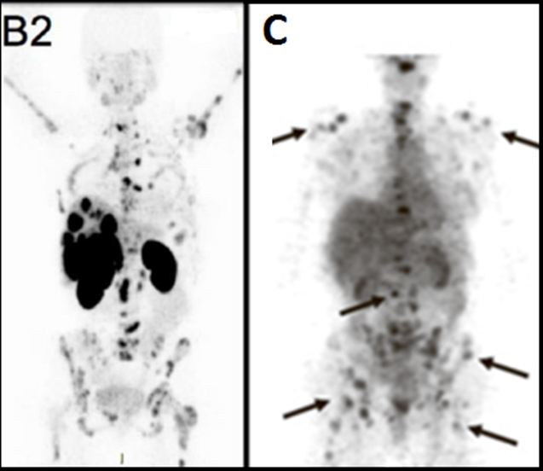

⁶⁸Ga-affibody ⁸⁹Ze-antibody
4 h p.i. 5 days p.i.

Slide 36
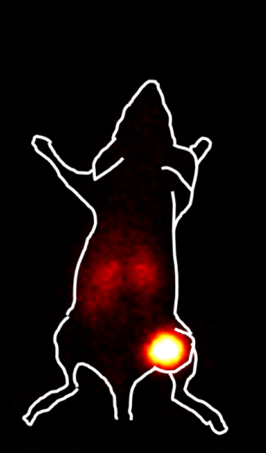
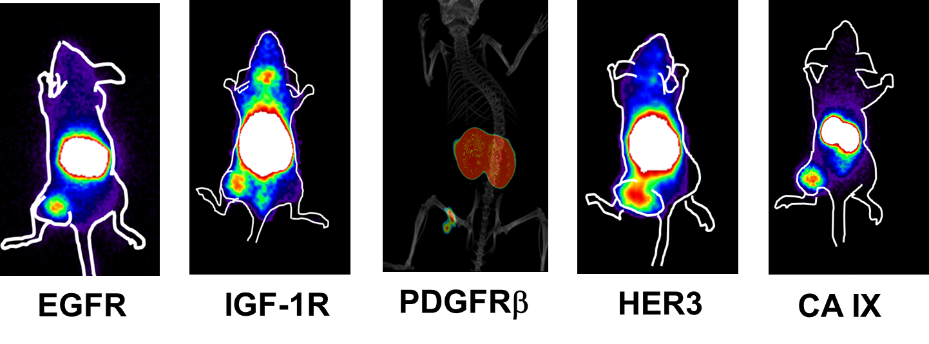
Affinities of
affibody molecules
HER2 0.022 nM Orlova: Cancer Res., 2006: 4339-48.
EGFR 0.9 nM Tolmachev: EJNMMI. 2010: 613-22.
IGF-1R 0.5 nM Tolmachev: J Nucl Med. 2012:90-97.
HER3 0.021 nM Orlova: EJNMMI. 2014: 1450-9
PDGFRβ 0.4 nM Tolmachev: J Nucl Med. 2014: 294-300.
CA IX 1.3 nM Honarvar: Int J Onc, 2015: 513-20.
HER2

Slide 37
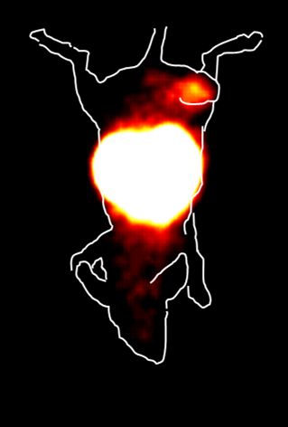
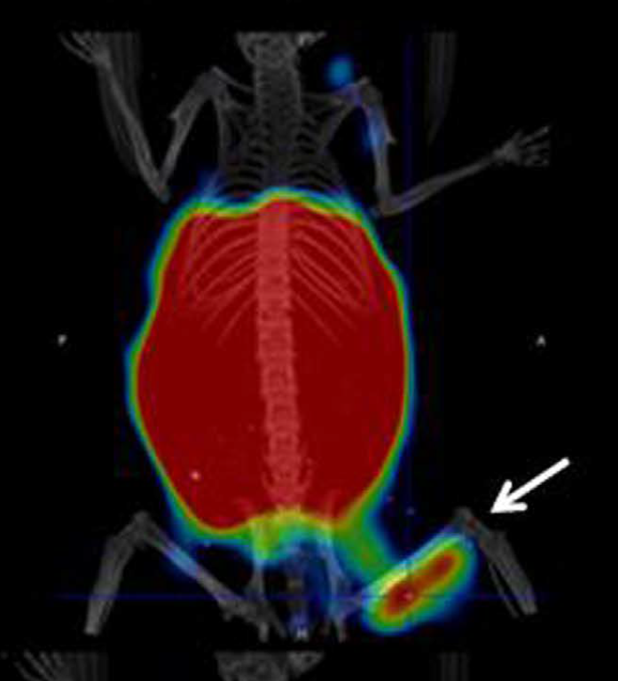
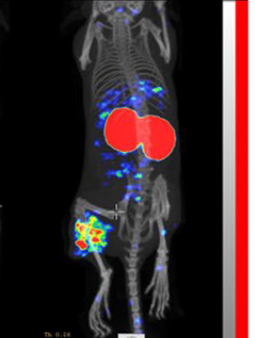
Starting
variant
Optimized
variant
EGFR
L
K
Tolmachev: Eur J Nucl Med, 2010:613
Garousi: Sci Rep 2017: 5961
HER3
L
K
Rosestedt: Sci Rep 2015: 15226
Rinne: Sci Rep 2019: 655

Slide 38

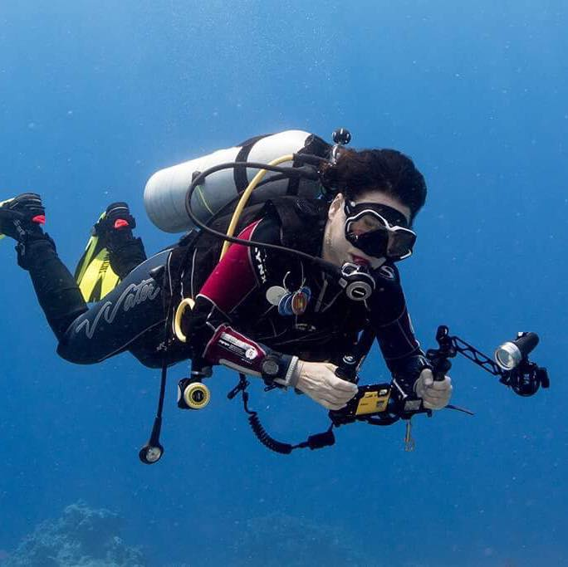
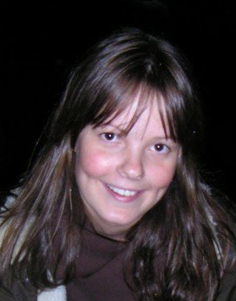
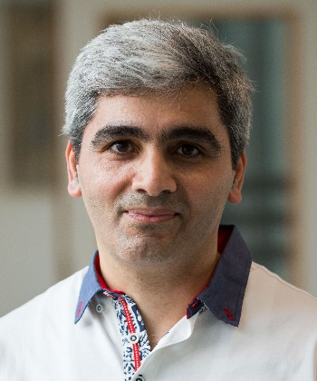
ADAPTs
(Albumin binding domain-Derived Affinity Proteins)

Slide 39
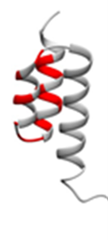
ADAPTs
(Albumin binding domain-Derived Affinity Proteins)
Molecular weight 5.2 – 7.5 kDa
Affinity
HER2 1.1 nM Garousi: Cancer Res 2015:4364
TNF-α 3 nM Nilvebrant: PLoS One. 2011: e25791.
HER3 10 nM Nilvebrant: Cell Mol Life Sci. 2013: 3973
Nilvebrant J, Hober S. Comput Struct Biotechnol J. 2013:e201303009.

Slide 40
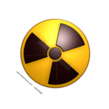
ADAPTs.
Proof-of-principle
GCSSHEHEHEDEAVDANSLAAAKETALYHLDRLGVADAYKDLIDKAKTVEGVKARYFEILHALPG
¹¹¹In/SPECT ⁶⁸Ga/PET
Garousi: Cancer Res 2015:4364

Slide 41
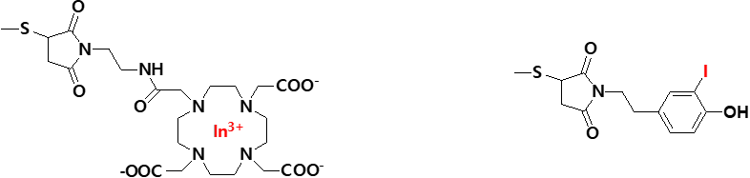

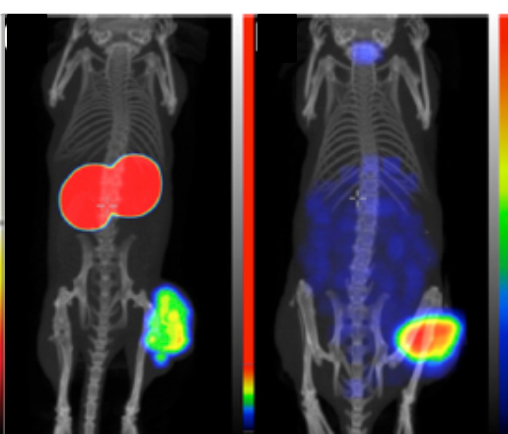
ADAPTs.
Influence of a label position
¹¹¹In ¹²⁵I
C-terminal labelling
is better!
Lindbo: J Nucl Med 2018: 93

Slide 42
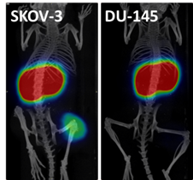

ADAPTs:
Optimization of imaging probes for PET
GCSSHEHEHEDEAVDANSLAAAKETALYHLDRLGVADAYKDLIDKAKTVEGVKARYFEILHALPG
GDEAVDANSLAAAKETALYHLDRLGVADAYKDLIDKAKTVEGVKARYFEILHALPGSSC
High expression
Low expression
*
Garousi, Lindbo: Sci Rep: 2017:14780
Garousi, Lindbo: Bioconjug Chem: 2016:2678
Lindbo, Garousi: Mol Pharm 2018:2674

Slide 43
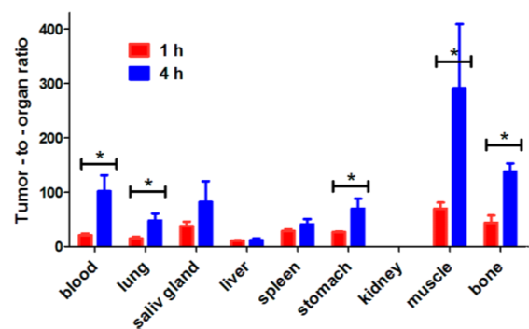
^{99m}Tc(CO)₃-H₆-ADAPT6:
Good targeting and low liver uptake
No blocking Blocking
Lindbo: Bioconjug Chem: 2016; 716

Slide 44



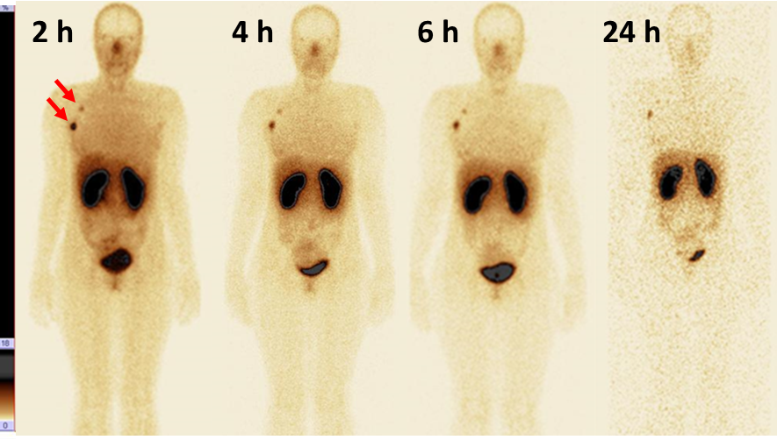
^{99m}Tc(CO)₃-H₆-ADAPT6:
Phase I clinical study (Tomsk)
Whole-body images at 2, 4, 6 and 24 h after injection of 500 µg ^{99m}Tc-ADAPT6

Slide 45
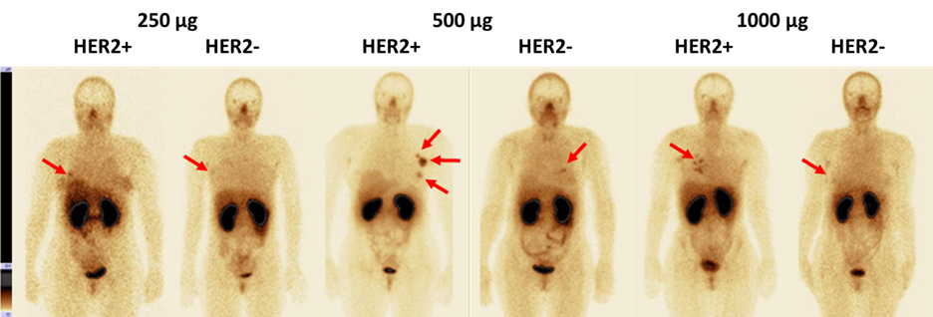
^{99m}Tc(CO)₃-H₆-ADAPT6:
Phase I clinical study (Tomsk)
Representative anterior images of patients with HER2 negative and HER2 positive tumors after injection of 250, 500 or 1000 µg ^{99m}Tc-ADAPT6.

Slide 46
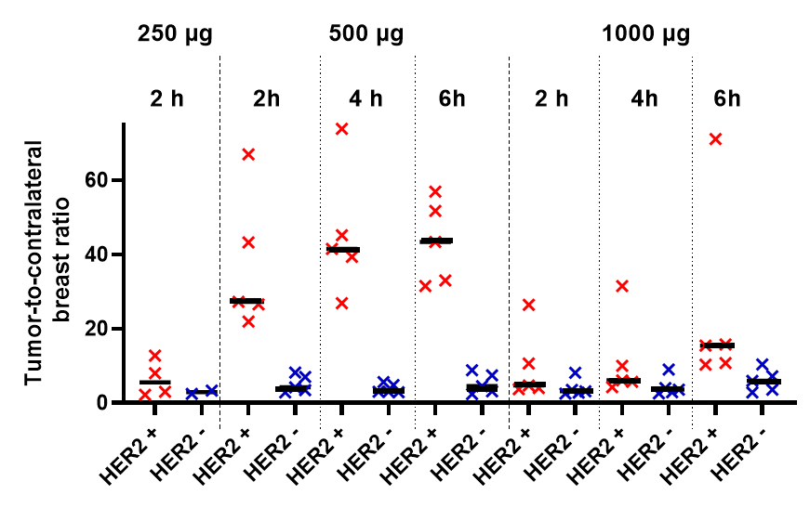
^{99m}Tc(CO)₃-H₆-ADAPT6:
Phase I clinical study (Tomsk)
Primary tumor-to-contralateral site ratio at 2 h after injection of 250 µg, and 2, 4 and 6 h after injection of 500 and 1000 µg ^{99m}Tc-ADAPT6.

Slide 47






Designed Ankyrin Repeat Proteins (DARPins)

Slide 48



DARPins:
HER2 imaging: first attempt
¹²⁵I
^{99m}Tc
Vorobyeva: Contrast Media Mol Imaging.
2018:6930425

Slide 49



DARPins:
HER2 imaging: second generation
9_29 G3
¹²⁵I
Mw Affinity
(kDa) (nM)
9_29 18.2 3.8
G3 14.3 0.091
^{99m}Tc
Deyev: Mol Pharm. 2019:955

Slide 50

DARPins:
HER2 imaging: further development
Vorobyeva, Deyev; submitted

Slide 51


DARPins:
EpCAM imaging
Specificity of uptake in EpCAM-positive pancreatic cancer
Vorobyeva, Deyev; unpublished

Slide 52



Different scaffold prefer different epitopes on the same target
Co-targeting is possible;
When use of one scaffold fails, the use of another one might succeed;
We need a large scaffold ”tool box” to ensure success.
Jost: Srucrture 2013:1979
Eigenbrot: PNAS 2010:15039

Slide 53
Chemical properties and position of chelator/linker for labelling of targeting proteins and peptides influence:
Predominant excretion pathway;
Uptake and retention in excretory organs;
Blood clearance rate (tracer and radiocatabolites)
influencing imaging contrast.
Careful studies concerning influence of labeling chemistry on biodistribution and targeting may make a difference between success and failure!

Slide 54






Development of scaffold-based imaging probes is inter- and cross-disciplinary work
Biotechnology
Preclinical
development
(radiochemistry, radiopharmacology)
Clinical
development
(nuclear medicine, oncology, dosimetry, immunology)

Slide 55
Take home message
Radionuclide imaging of ”gatekeeping” molecular targets may make cancer treatment more personalized and more efficient;
Smaller imaging probes improve both sensitivity and specificity of imaging;
The use of scaffolds enables to develop small high-affinity probes to variety of cancer-associated molecular targets;
Correct molecular design and optimal labeling chemistry are critical for high sensitivity and specificity;

Slide 56
Anna Orlova Sergey Deyev
Lars Abrahmsén Sara Ahlgren
Mohammed Altai Karl Anderson
Anzhelika Vorobyeva Caroline Ekblad
Torun Engfeldt Veronika Eriksson
Joachim Feldwisch Fredrik Y Frejd
Torbjörn Gräslung Monika Hansson
Göran Hendestierna Magnus Hjertman
Javad Garousi Camila Hofström
Sayed Jalal Hosseinimehr Ingmarie Höidén-Guthengerg
Amelie Eriksson Karlström Hans Lundqvist
Mikaela Magnusson Jennie Malmberg
Per-Åke Nyström Rikard Pehrson
Daniel Rosik Mattias Sandström
Anna Sjöberg Sharon Stone-Elander
Stefan Ståhl Thuy Tran
Maryam Oroujeni Helena Wållberg
Anders Wennborg Kenneth Wester
Zohreh Varasteh Joanna Strand
Hadis Honorvar Maria Rosestedt

Slide 57


