Slide 1

Optimal molar activity is a precondition for a sensitive and specific molecular imaging in oncology
Radiolabelled proteins and peptides
Vladimir Tolmachev
Uppsala University, Uppsala, Sweden

Slide 2
Definition
Activity (GBq)
Specific activity (A_{c}) =
Mass of imaging probe (µg)
Activity (GBq)
Molar activity (A_{m}) =
Amount of imaging probe (µmol)
Coenen et al. Nucl Med Biol. 2017;55:v-xi.

Slide 3
What is the weight of 370 MBq of ^{99m}Tc ?
A = λ × N = ln(2) × N/T_{1/2} = 0.693 × N/T_{1/2}
N = A × T_{1/2}/ 0.693
A= 370 MBq = 3.7 ×10² × 10⁶ = 3.7 × 10⁸
T_{1/2} = 6 h= 6 × 3.6 ×10³ s = 2.16 × 10⁴ s
N = 3.7 × 10⁸ × 2.16 × 10⁴ /0.693 = 1.1 × 10¹² atoms
Mol : 1.1 × 10¹² /6.02 × 10²³ = 1.8 × 10⁻¹² mol
W = 99 × 1.8 × 10⁻¹²= 1.78 × 10⁻¹⁰ g
Is it easy to work with such small amount of substance?

Slide 4
CARRIER: An inactive material deliberately added to a specified radioactive substance to ensure that the radioactivity will behave normally in all subsequent chemical and physical processes.
ISOTOPIC CARRIER: A carrier which differs only in isotopic composition from the trace substance it has to carry.
NONISOTOPIC CARRIER: A carrier which is not an isotope (that is, it is a different element) of the trace substance or substances it has to carry.

Slide 5
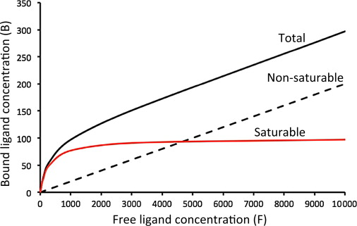
Specific binding of a ligand to a receptor is saturable!
Exceedingly high concentration of a ligand does not contribute to a specific binding but contributes to unspecific!
= Non-specific
= Specific
B = B_{max} × F/(K_{D}+F)

Slide 6

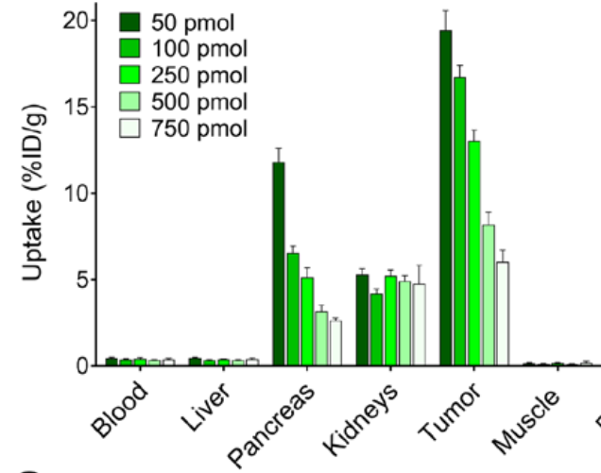
Specific binding of a ligand to a receptor is saturable!
Exceedingly high concentration of a ligand does not contribute to a specific binding but contributes to unspecific!
In the case of radionuclide therapy, molar activity must be high!

Slide 7
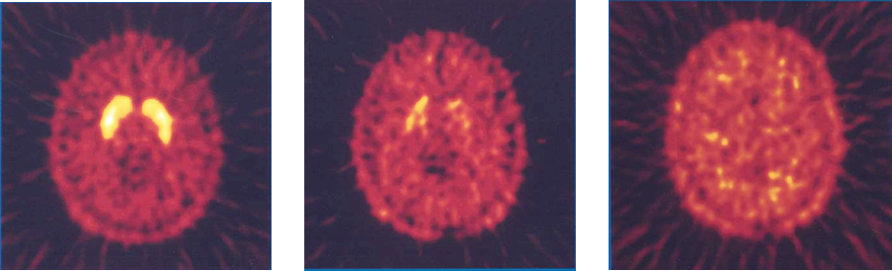
Imaging of dopamine receptors in brain using [¹¹C] raclopride
High specific Medium specific Low specific
activity activity activity
In the case of imaging of a high-affinity low-capacity system, molar activity must be as high as possible!

Slide 8
Conclusions
In the case of radionuclide therapy, molar activity must high!
In the case of imaging of a high-affinity low-capacity system, molar activity must be as high as possible!
Adding of carrier is utterly undesirable in these cases

Slide 9
Some terms characterizing
molar (specific) activity of radionuclides
Carrier added. Some amounts of stable isotopes were deliberately added to facilitate the separation/isotopic target material is not separated.
Carrier free. No stable isotopes are present in the preparation.
Ex. ²¹¹At, artificial trans-uranium
elements
No carrier added. Stable isotopes were not deliberately added.
Ex. Majority of cyclotron-produced
nuclide

Slide 10
Molar activity of an injected imaging radiopharmaceutical
Determined by dosimetry
Activity (GBq)
Molar activity (A_{m}) =
Amount of imaging probe (µmol)
High molar activity means low amount of an injected imaging probe for a given injected activity.

Slide 11
Molar activity of an injected imaging radiopharmaceutical
Determined by dosimetry
Activity (GBq)
Molar activity (A_{m}) =
Amount of imaging probe (µmol)
High molar activity means low amount of an injected imaging probe for a given injected activity.
Is low injected amount always good?

Slide 12
Somatostatin receptor imaging
Uptake of [¹¹¹In-DOTA0,Tyr3] octreotide in CA20948 xenografts in rats.
“… the quality of tumour scintigrams obtained with the lowest peptide amount tested (1 μg) was significantly worse than the quality of those obtained with higher peptide masses (5–120 μg), such that tumours were missed in the low mass scintigrams.”
Kooij PPM et al. J Nucl Med. 1994;226P
Kwekkeboom et al. J Nucl Med 2000; 1704
De Jong et al Eur J Nucl Med 1999: 693
Notes:
“These findings have also been confirmed by research on humans, which has shown that when a standard dose of 220 MBq ¹¹¹In is coupled to less than 5 µg [DTPA⁰]octreotide, there is a decreased quality of scintigraphy and a significantly reduced uptake in tumors.”
EC voulme 14 liters
Kd 5 nM

Slide 13

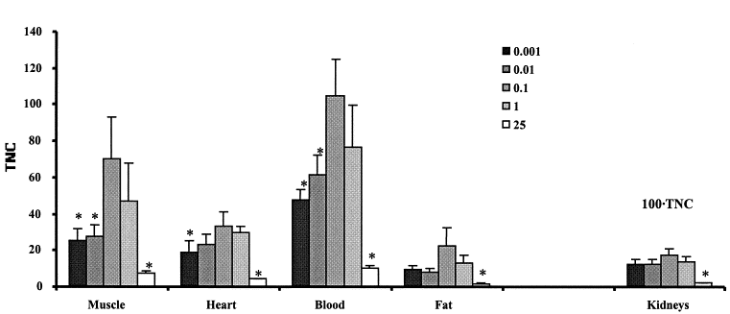
¹¹¹In-DTPA-D-Phe¹-octreotide in mice bearing GOT1 xenografts (24 h p.i.)
Bernhardt et al. Nucl Med Biol 2003:253

Slide 14
Targeting of GRPR with radiolabelled bombesin analogs
⁶⁷Ga-BZH3 in AR42J xenografts in mice (1 h p.i.)
¹¹¹In-NOTA-P2-RM26 in PC-3
xenografts in mice (2 h p.i.)
Schuhmacher et al. J Nucl Med 2005:691
Varasteh et al. Bioconjugate Chem. 2013: 1144

Slide 15
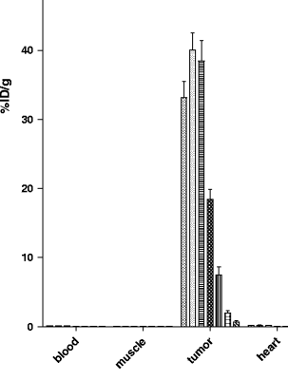

Targeting of GLP-1R using [Lys⁴⁰(¹¹¹In-DTPA)]exendin-3
INS-1 xenografts in mice
4 h p.i.
Brom et al. Eur J Nucl Med Mol Imaging. 2010:1345.

Slide 16
Conclusions
For several radiolabelled peptides, the lowest injected mass does not provide the highest tumour uptake and the highest tumour-to-organ ratios.
The optimal injected mass is not the lowest one. ➔ The optimal molar activity is not the highest one.

Slide 17
Overcoming an interception of an antibody by a shed antigen
CEA
TAG72
mesothelin
human kallikrein 2 (hK2)

Slide 18
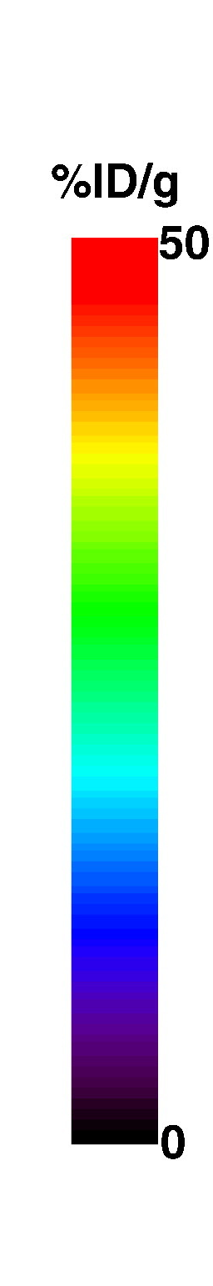
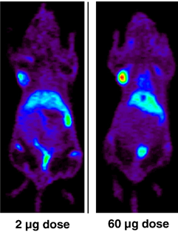
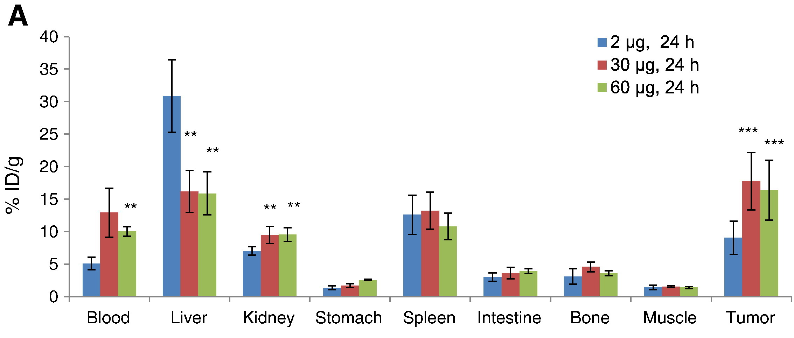
Mesothelin imaging using ⁸⁹Zr/⁶⁴Cu-amatuximab
24 h
⁶⁴Cu-amatuximab
“The findings of this study imply that the systemic mAb concentration should be at a severalfold molar excess to the shed Ag concentration in the blood”
Lee et al. Nucl Med Biol 2015: 880
Lee et al. Nucl Med Biol 2015: 880

Slide 19
Conclusions
Increase of an injected antibody mass permits to suppress an interception of labelled antibodies by shed antigen in circulation.
The optimal injected mass in the case of shed antigen is not the lowest one. ➔ The optimal molar activity is not the highest one.

Slide 20
Preventing imaging probe uptake and sequestration in normal target-expressing tissues

Slide 21
Imaging of EGFR-expressing tumours using ¹¹¹In-MAb225
Hepatic uptake Tumour uptake
3 h p.i.
4 mg 120 mg
“Imaging of tumors was successful at doses of and above 20 mg, and a dose of 120 mg was optimal for SPECT imaging.”
Divgi et al. J Natl Cancer Inst. 1991:97-104.
Notes:
Imjected dose range from 1 to 300 mg
Patients with squamous cell lung carcinoma.
Tumors were imaged when injected dose was 20 mg or more
Metstases were imaged when injected dose was 40 mg or more

Slide 22
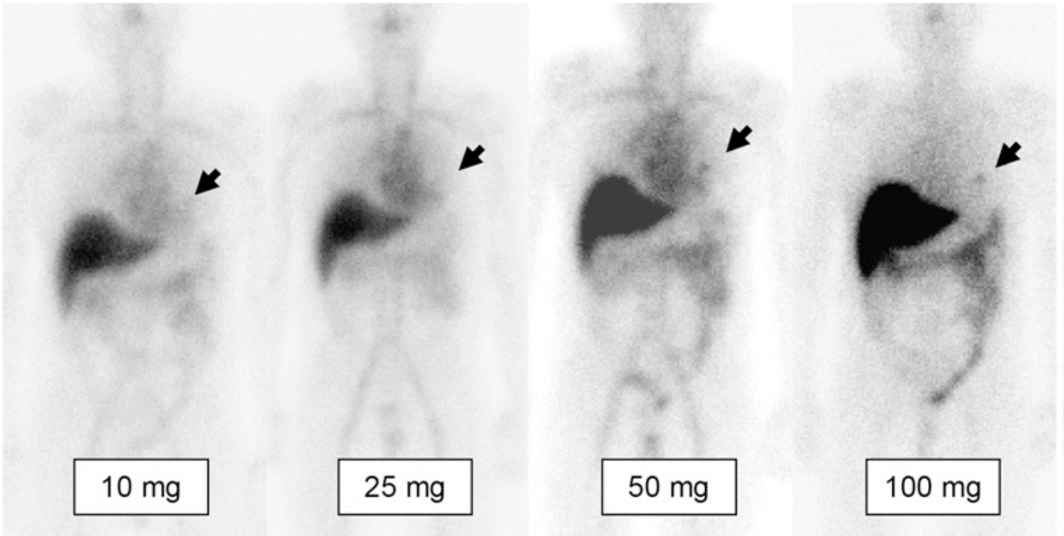
PSMA imaging using ¹¹¹In-J591
Relative uptake
10 mg 50 mg 100 mg
Liver 1 0.65 0.48
Tumour 1 1.8 1.67
“The higher–antibody mass scans showed an increased number of lesions.”
Morris et al. Clin Cancer Res. 2007:2707-13.
Pandit-Taskar et al. J Nucl Med 2008:1066–1074
Notes:
Imaging using 10, 25, 50 and 100 mg
” Lesions were more detectable on scans obtained with later infusions with higher (50–100 mg) antibody masses (Fig. 2).”
” These are shown in Figure 3. The lesion–to–whole-body ratio reached a maximum for an antibody mass of 50 mg. In contrast, the lesion-to-liver ratio continued to increase up to the maximum antibody mass administered (100 mg).”
” Irrespective of the parameters used, the findings were consistent and may be summarized as follows: increasing the mass of antibody administered results in an increased proportion of antibody retained in the circulation, in lesions, and in the whole body in general and a reduced proportion retained in the liver.
These results are consistent with the hypothesis that the liver acts as a saturable sink for circulating antibody. Low amounts of antibody are rapidly removed from the circulation, leading to relatively low lesion uptake. As the amount of circulating antibody increases, the liver gradually saturates, a higher proportion remains in the circulation, and the relative lesion uptake increases.”

Slide 23
HER2 imaging using ⁸⁹Zr-trastuzumab
10 mg 3 days p.i.
50 mg trastuzumab
4 days p.i.
10 mg during
trastuzumab
3 days p.i.
10 mg during
trastuzumab
5 days p.i.
Trastuzumab naive
Dijkers et al. Clin Pharmacol Ther. 2010:586

Slide 24
EGFR targeting in murine xenografts using ¹¹¹In-labelled affibody molecule ZEGFR:1907 (4 h pi)
Tolmachev et al. J Nucl Med. 2009:274

Slide 25
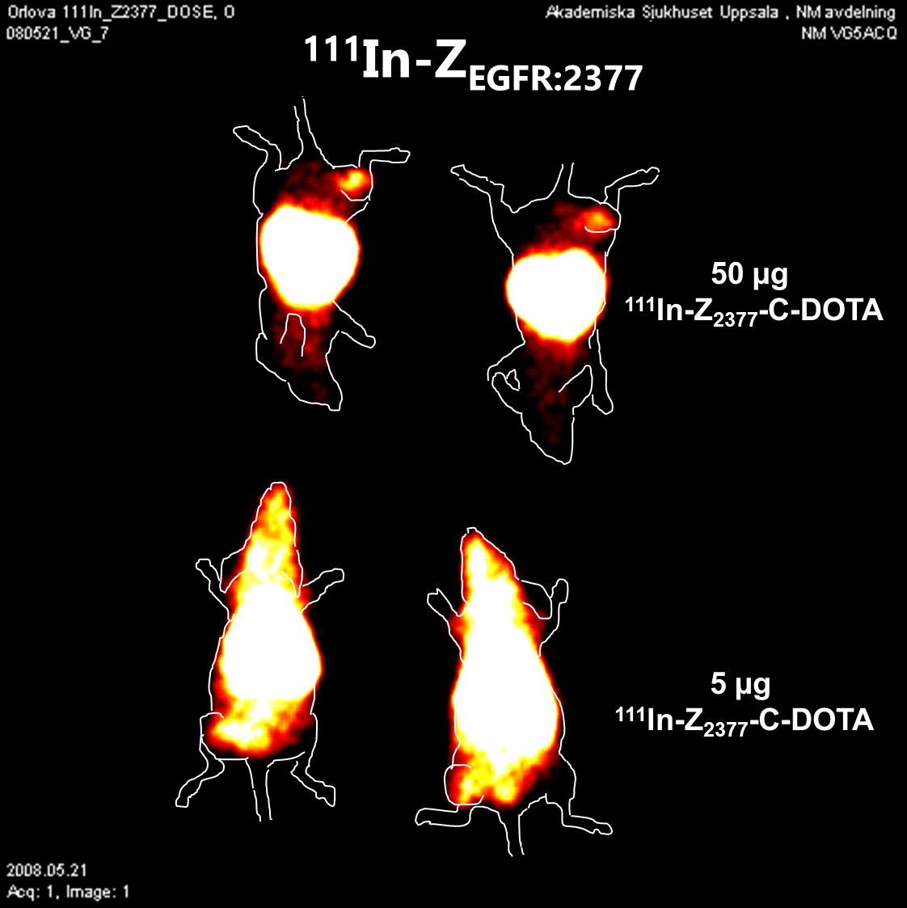
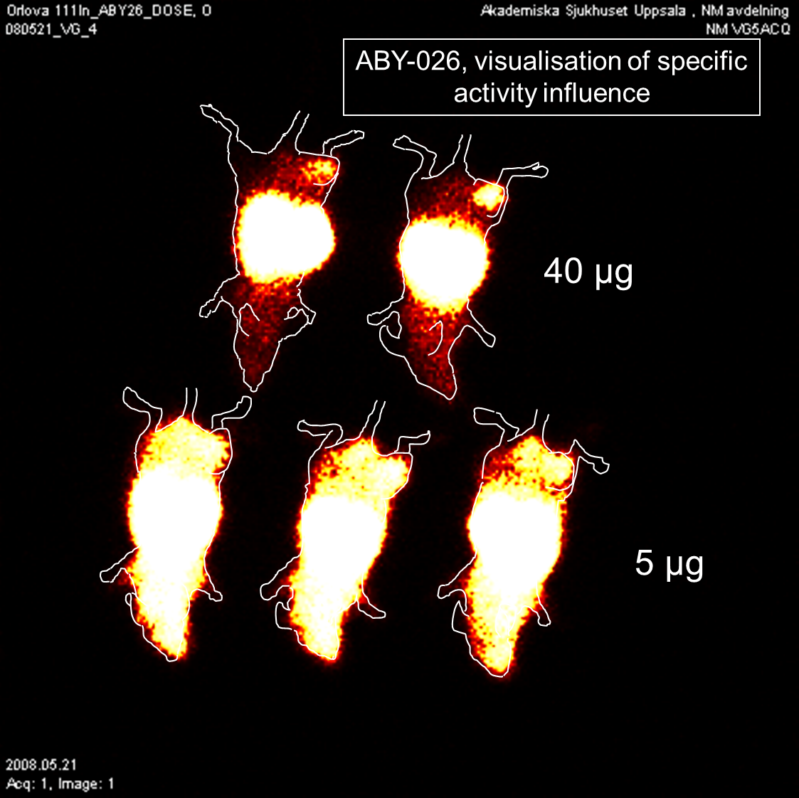
Imaging of EGFR expression in murine xenografts using ¹¹¹In-labelled affibody molecules
Tolmachev et al. J Nucl Med. 2009:274-83
Tolmachev V, unpublished

Slide 26
HER2 imaging using ⁶⁸Ga-labelled affibody molecule ABY-025
ID = 100 µg
ID = 500 µg
Uptake images of [⁶⁸Ga]ABY-025 with low (LD) and high administered peptide dose (HD) at 1, 2 and 4 hours after injection in patient 2. All images are normalized to the same scale of SUV 10
Sörensen et al. Theranostics. 2016:262-71

Slide 27
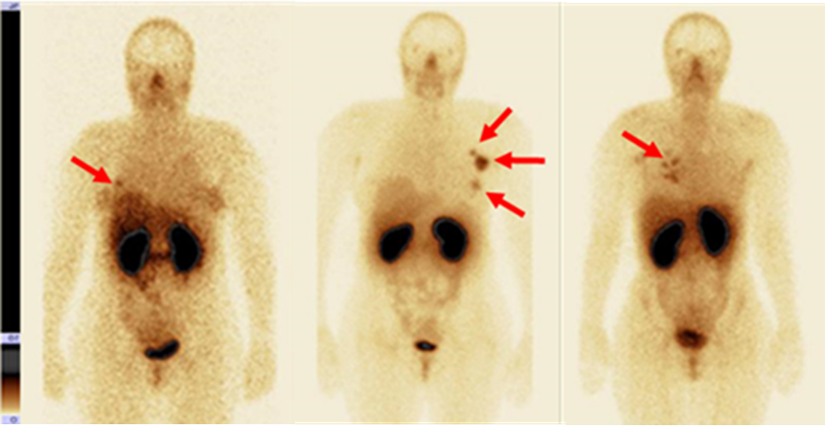
HER2 imaging using ^{99m}Tc-labelled ADAPT6
250 µg 500 µg 1000 µg
Bragina et al. J Nucl Med, under reviewing

Slide 28
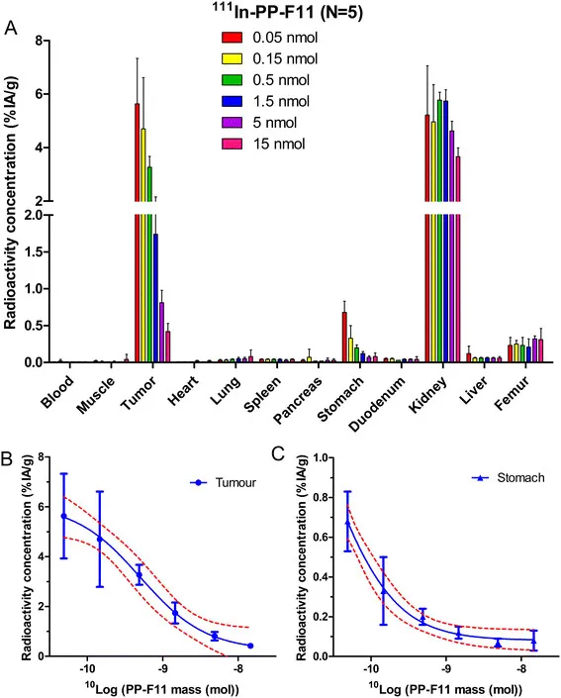
Targeting of CCK2R using ¹¹¹In-labelled minigastrin analogue PP-F11
Konijnenberg et al. EJNMMI Res. 2014:47
Notes:
10-fold increase /form 0.05 to 0.5 nmol/- tumor uptake decreases ca. 2-fold; stomach uptake ca. 3.3-fold

Slide 29
Molar Activity of Ga-68 Labeled PSMA Inhibitor Conjugates Determines PET Imaging Results
Wurzer et al Mol Pharmaceutics 2018: 4296

Slide 30
Conclusions
Increase of injected mass permits radiolabelled proteins and peptides to break though the “liver barrier” in the case of target expression on hepatocytes;
Increase of injected mass (decrease of molar activity) permits to minimize uptake of radiolabelled proteins and peptides in target-expressing tissues and increase tumour-to-tissue ratios;
The optimal injected mass is not the lowest one.➔ The optimal molar activity is not always the highest one.

Slide 31
Discrimination between tumours with high and low target expression levels

Slide 32
Expression of HER2
IHC Number of receptors per cell
Score
0 < 20 000 receptors per cell
1+ 100 000 receptors per cell (< 10% cells with
partial membrane staining)
2+ 500 000 receptors per cell (> 10% cells with
light to moderate membrane staining)
3+ 2 300 000 receptors per cell (> 10% cells with
complete membrane staining)
Ross et al. Mol Cell Proteomics. 2004:379

Slide 33
Influence of injected mass of affibody molecule on uptake in tumours with high and low expression of HER2
Tolmachev et al. Eur J Nucl Med Mol Imaging 2010:531.

Slide 34
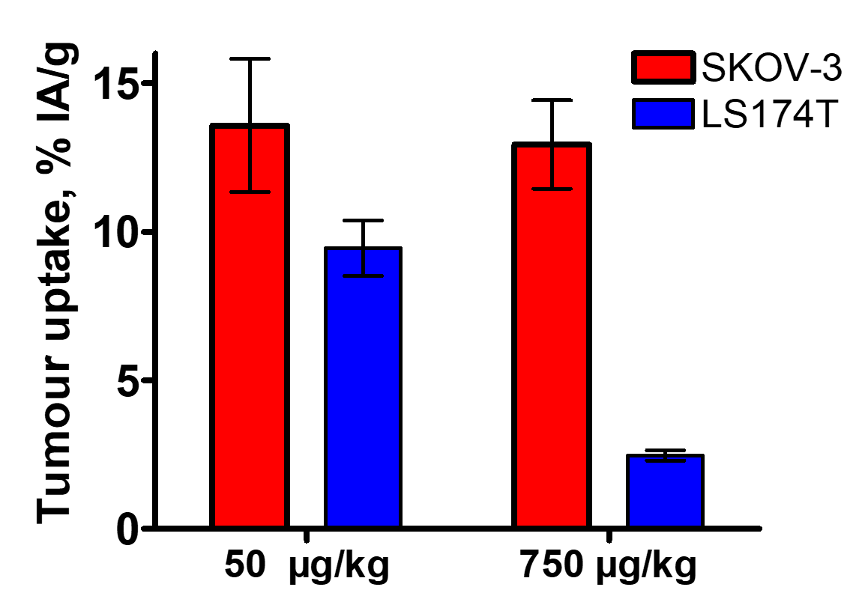
Tolmachev et al. Eur J Nucl Med Mol Imaging 2010:531.

Slide 35
A
A
T = T₀
A
A
C_{R} = 0
A
A
A
A
A
A
A
A
A
blood
tissue
C_{R} – receptor concentration in tissue;
C_{Ablood} –Affibody concentartion in blood;

Slide 36
A
A
T = T_{max}
A
C_{R} = 0
A
A
A
A
A
A
A
A
A
A
L _{max}
blood
tissue
L = f (P, C_{Ablood}, D)
P-capillary permeability, ~ 1/m^{1/2})
D-diffusion coefficient, ~ 1/m^{1/2})

Slide 37
A
A
A
A
A
A
A
A
A
L _{max}
blood
tissue

Slide 38
A
R
R
R
A
A
A
R
R
R
R
R
R
A
R
R
R
R
R
R
R
A
A
R
R
R
R
R
A
R
A
R
R
R
R
L _{max}
blood
tissue
R
High receptor density, high specific radioactivity:
penetration is limited but nearly all Affibody molecules are bound to receptor and retained in tumor

Slide 39
R
R
A
A
R
R
R
R
A
A
R
R
A
A
A
R
R
R
R
R
A
A
R
L _{max}
blood
tissue
Low receptor density, high specific radioactivity:
penetration is deeper, and still, nearly all Affibody molecules are bound to receptor and retained in tumor

Slide 40
R
R
A
A
R
R
R
R
A
A
R
R
A
A
A
R
R
R
R
R
A
A
R
L _{max}
blood
tissue
Low receptor density, low specific radioactivity:
A part of receptors within Affibody molecules range is blocked by non-labeled ligands. Radioactive signal from tumor decreases.

Slide 41
Conclusions
too high specific radioactivity (= too low injected mass) of ¹¹¹In-DOTA-Z_{HER2:342} complicates discrimination between xenografts with high and low expression of HER2;
optimal specific radioactivity enables discrimination between xenografts with high and low expression of HER2;
Tolmachev et al. Eur J Nucl Med Mol Imaging 2010:531-539.

Slide 42
Conclusions:
In the case of radionuclide therapy, molar activity must be high!
In the case of imaging of a high-affinity low-capacity system, molar activity must be as high as possible!
Adding of carrier is utterly undesirable in these cases

Slide 43
Conclusions:
For several radiolabelled peptides, the lowest injected mass does not provide the highest tumour uptake and the highest tumour-to-organ ratios.
Increase of an injected antibody mass permits to suppress an interception of labelled antibodies by shed antigen in circulation.
Increase of injected mass permits radiolabelled proteins and peptides to break though the “liver barrier” in the case of target expression on hepatocytes;
Increase of injected mass (decrease of molar activity) permits to minimize uptake of radiolabelled proteins and peptides in target-expressing tissues and increase tumour-to-tissue ratios;

Slide 44
Conclusions:
too high specific radioactivity (= too low injected mass) of ¹¹¹In-DOTA-Z_{HER2:342} complicates discrimination between xenografts with high and low expression of HER2;
optimal specific radioactivity enables discrimination between xenografts with high and low expression of HER2;
The optimal injected mass is not always the lowest one.➔ The optimal molar activity is not always the highest one.

